Slide 1
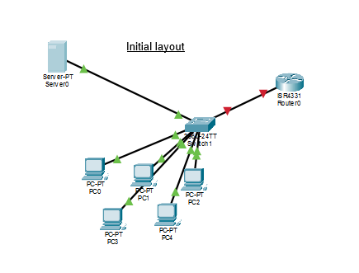
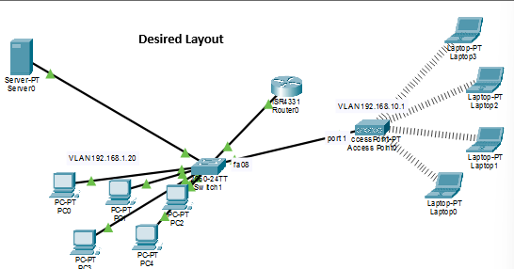
Project Brief
Project goal: Simulate office networking
Phase 1: 1 LAN set up through DHCP IP distribution
Phase 2: Add 1 VLAN and set up to DHCP as well
Tools used for simulation: Cisko Packet Tracer
Enjoy!

Slide 2
Network Infrastructure Deployment
Initial layout includes ROUTER and five PC’s connected to a switch that connects to the server.
Designed for internal network with no WIFI.

Slide 3
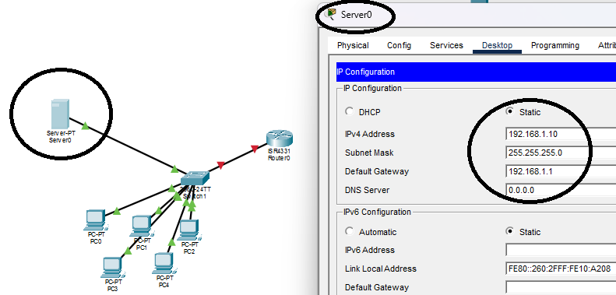
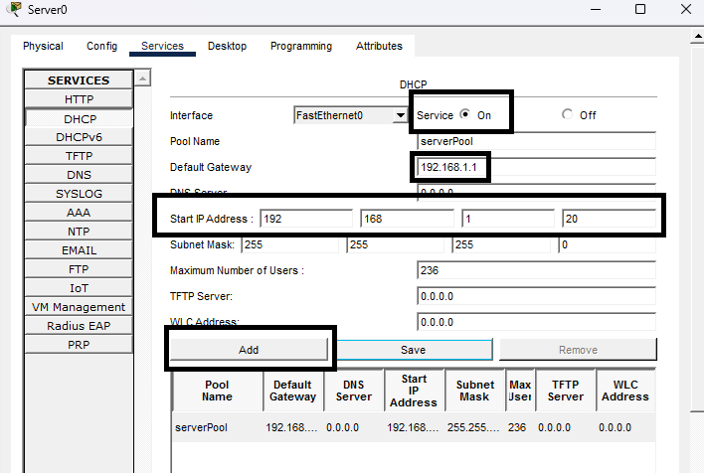
Server Config
SETTING up the SERVER
IP: (server): 192.168.1.10
SM:255.255.255.0
Default Gateway: 192.168.1.1
Turning on the DHCP
* Turn the DCHP ON
* Set the default gateway
* Start IP address range from 192.168.1.20
Add to pool
SAVE

Slide 4
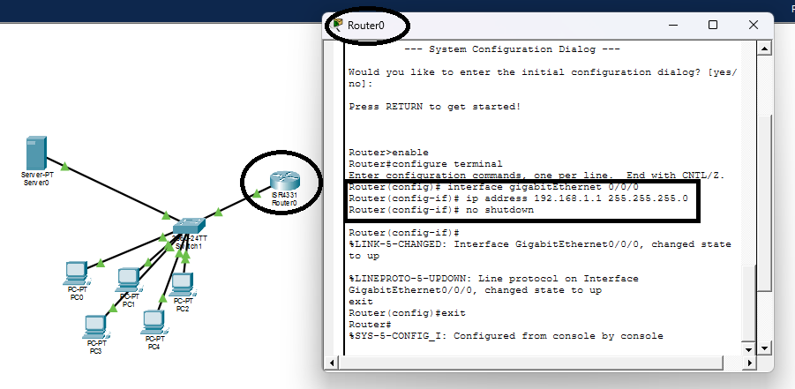
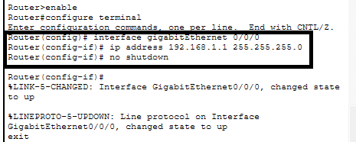
Setting up the ROUTER
ROUTER’s CLI
Created the interface for 0/0/0
Entered IP address for the ROUTER 192.168.1.1 and SM 255.255.255.
Forced NO SHUTDOWN

Slide 5
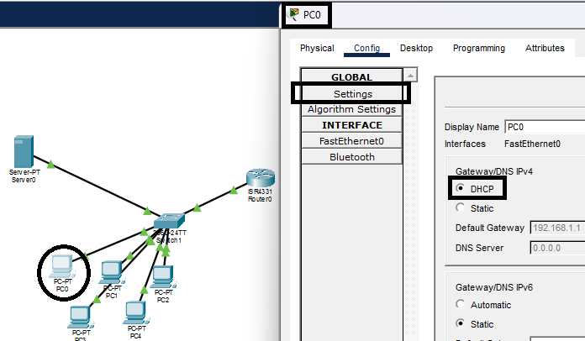
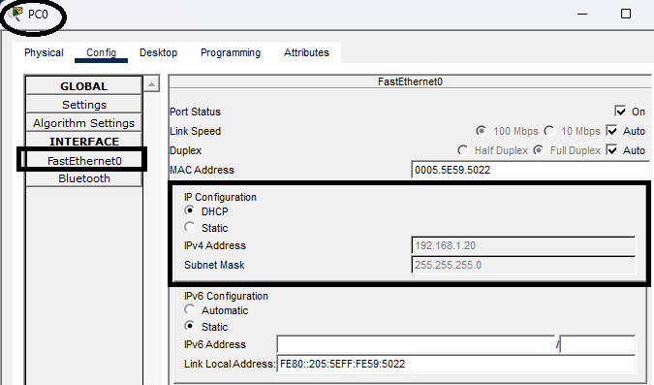
PC DHCP Config
Entered PC0
Settings
Turn on DHCP
In FastEthernet I can see the “magic happen”
The magic: The IP address auto fills as per DHCP
PC0 receives the first IP number in the LAN: 192.168.1.20
When setting up the SERVER previously, the IP addresses assigned are starting from X.X.X.20

Slide 6
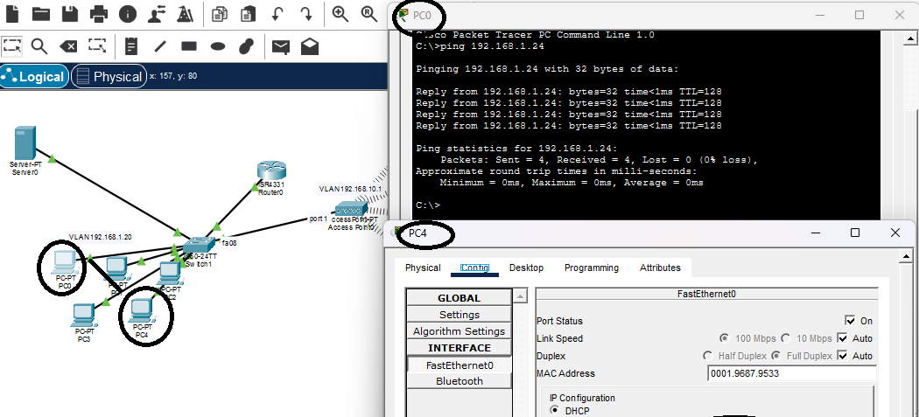
Ping To Prove Communications
PING

Slide 7
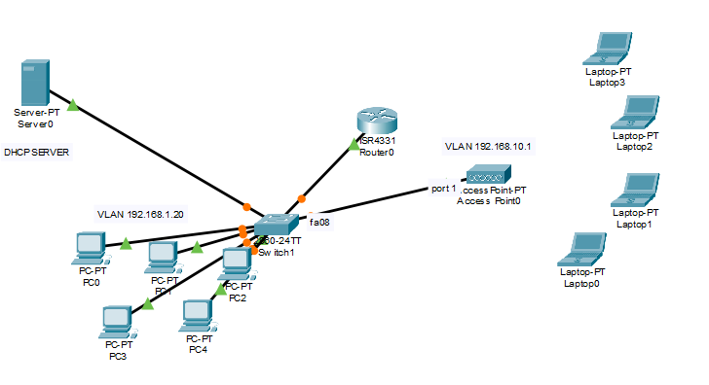
Adding a new VLAN
In this scenario we have opened a new department and want to connect some LAPTOPS through WI FI
New Vlan:
192.168.10.1
New hardware:
Access Point added

Slide 8
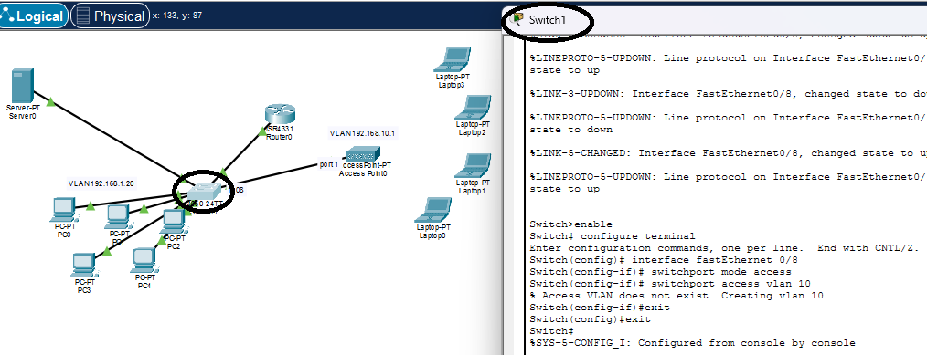
Switch Config – Create VLAN 10 for PC’s

Slide 9

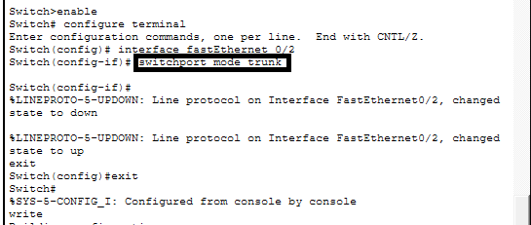
Switch Config
Zoom in to VLAN setup for laptops – VLAN 10
Setting up Trunk

Slide 10
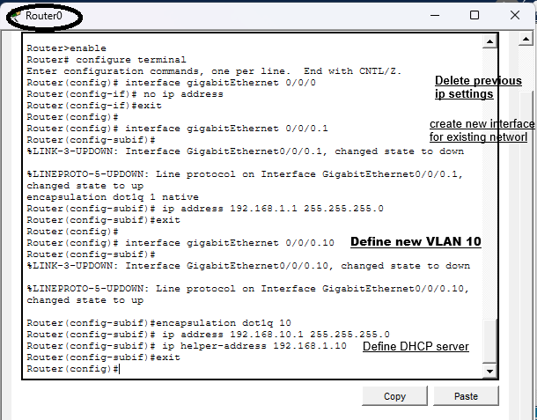
Router Config
Delete previous IP settings for the interface created for 0/0/0
Create new interface for the existing network (the PC’s) 0/0/0.1 IP: 192.168.1.1 (same)
Create new VLAN for 0/0/0.10
IP: 192.168.1.10
Helper-address to define DHCP server

Slide 11
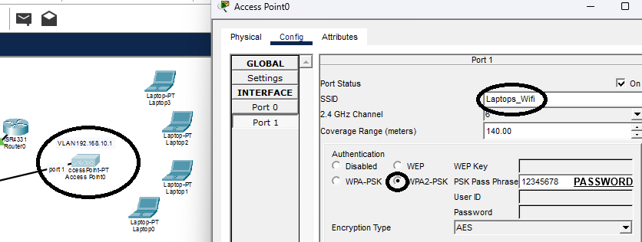
Access Point Config
Change the name of the SSID card
Set authentication to Password – WPA2-PSK
Enter company password – in this example it’s set to 12345678

Slide 12
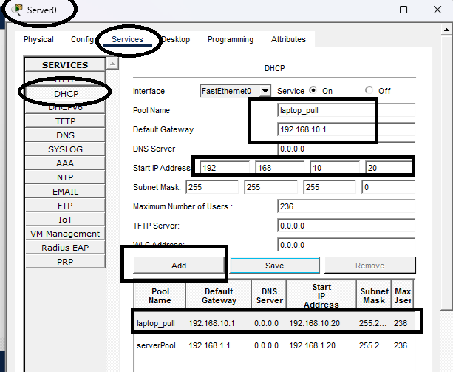
Server Config – Create new pool
SERVER -> Services ->DHCP
Creating a new pool named laptop_pool
Seting default Gateway
Defining start IP address at 192.168.10.20
ADD -> SAVE
New pool added for the new VLAN named laptop_pool

Slide 13
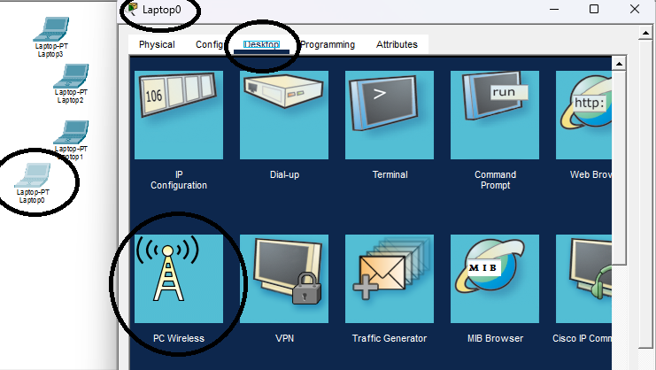
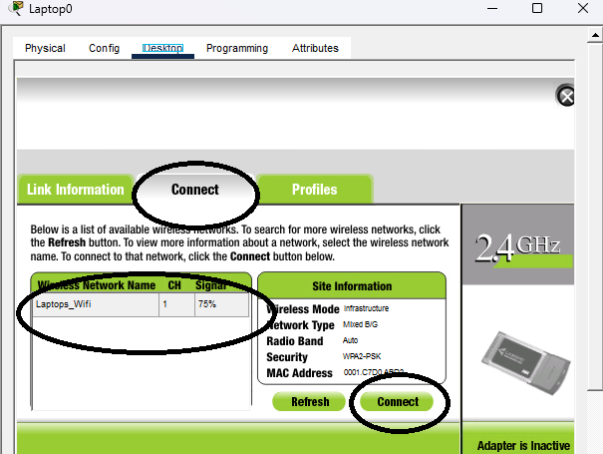
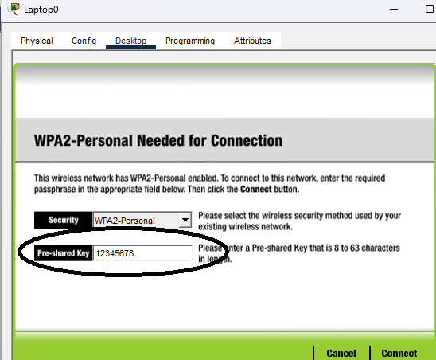
Laptop Config – Part 1
Entered Laptop0
Desktop ->WIRELESS
Connect -> laptop_wifi->Connect
Enter password –> 12345678 -> Connect

Slide 14
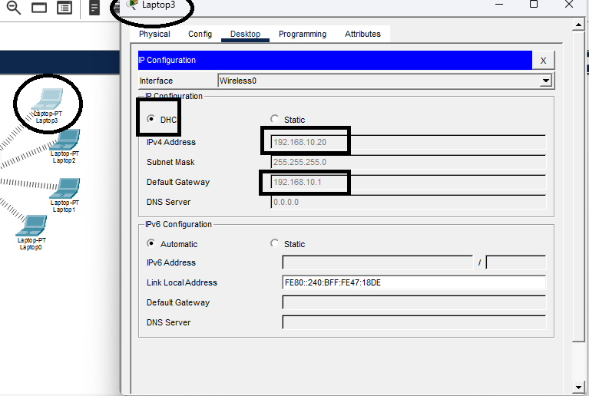
Laptop Config – Part 2
Desktop->
IP Config->
Select DHCP
Result
IP set to VLAN automatically Default Gateway set automatically

Slide 15
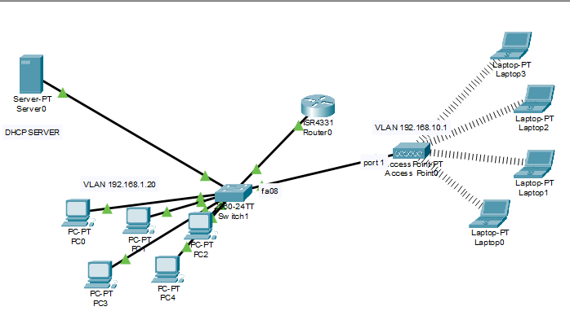
THANK YOU FOR WATCHING

